Slide 1
Smart human-centric lighting systems. Toward to “Lighting 4.0” era
Prof. Georges ZISSIS
georges.zissis@laplace.univ-tlse.fr
Smart Lighting Days
6-8 October 2021

Slide 2
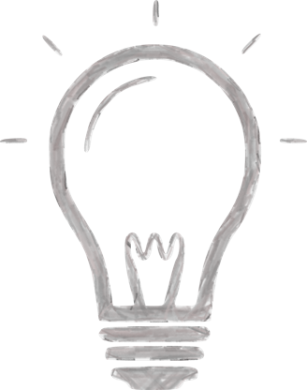
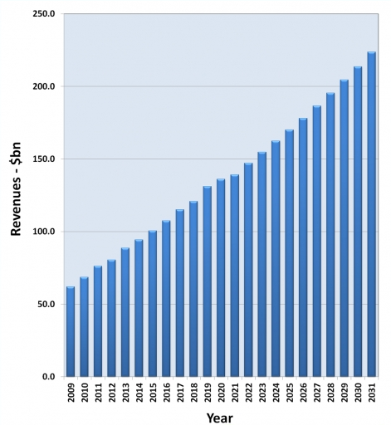
Some global figures
13-14% 2 900 TWh of annual electricity world-production for generating artificial light
30 000 000 000 More than 30 billion electric lamps operate everyday worldwide
~2% 2% of world annual energy primary resources used
40-45%
LED market revenue share
$120 000 000 000 Lighting industry annual turnover US$ 120 billion and still growing.
1 150 000 000 metric tons CO₂ 5% of the world CO₂ annual emissions = 230 million people CO₂ emissions
Artificial lighting has a large impact on energy, environment but also on every day’s life and world’s economy

Slide 3
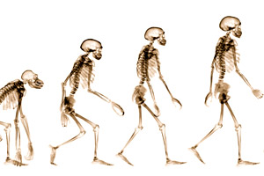
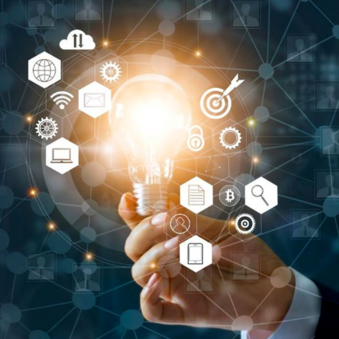
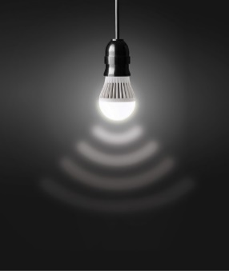
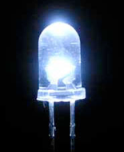
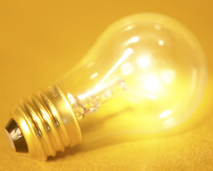
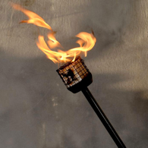
The way forward to Lighting 4.0 era
Mid 21st c.
Lighting 4.0
Earl 21st c.
Lighting 3.5
End 20th c.
Lighting 3.0
End 19th c.
Electrical Lighting
Lighting 2.0

Slide 4
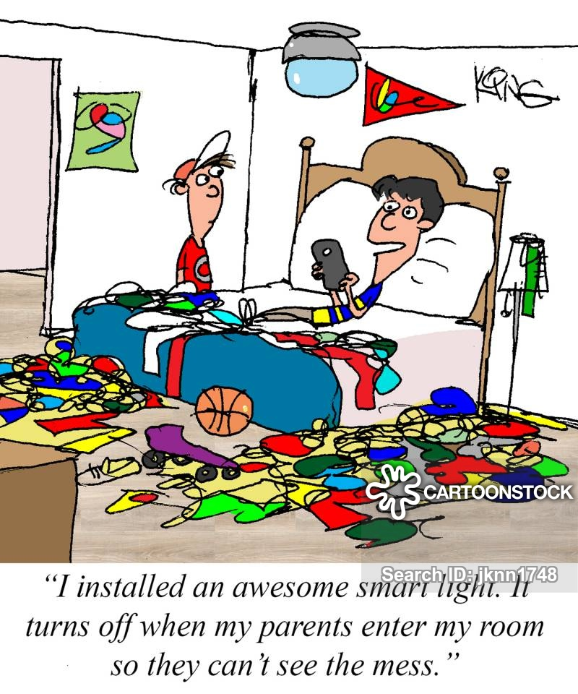
What is a smart lighting system?
A smart lighting system principal function is to produce, at any moment, the right light: where it is needed and when it is necessary. It should adapt the quantity and quality of light to enhance visual performance in agreement with the type of executed tasks. It must guarantee well-being, health and safety of the end-users. It should not squander passively the resources of our planet and limit actively the effects of light pollution on the biotope, or, any other impacts on the environment.
Ideally, the system could offer additional services (e.g. geo-localisation, data connectivity…) to the end-users through Visual Light Communication protocols.
Adapt dynamically the light quantity, light distribution in space and light quality (CCT, IRC, spectrum…) to optimise visual performance and respect any normative requirements
Avoiding any visual disturbance (glare, light flicker, strobe effects, shadows…) that can compromise end-user’s security and well-being at any moment.
Always reduce energy consumption of the installation without compromising the above conditions
Actively limit the effects of light pollution on the eco-system and biotope, respecting that new sky-protection legislations/standards.
If necessary, relay information via VLC methods (e.g. provide glocalization reference) .
Smart Lighting Functions

Slide 5
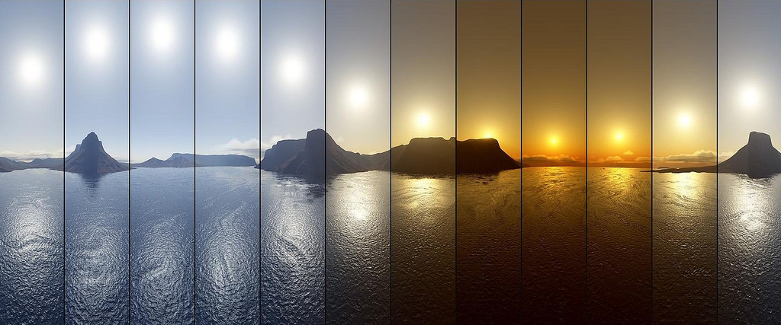
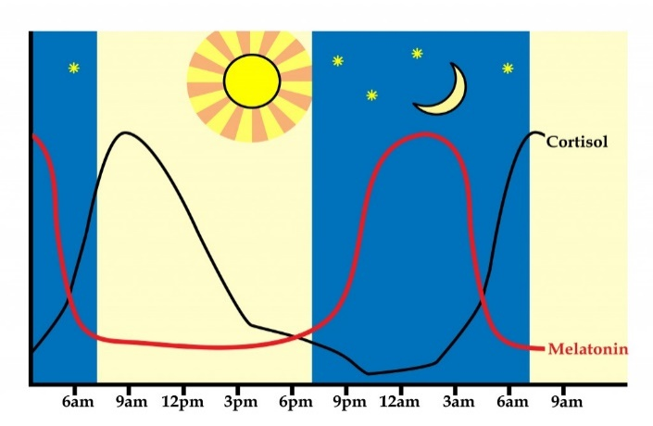
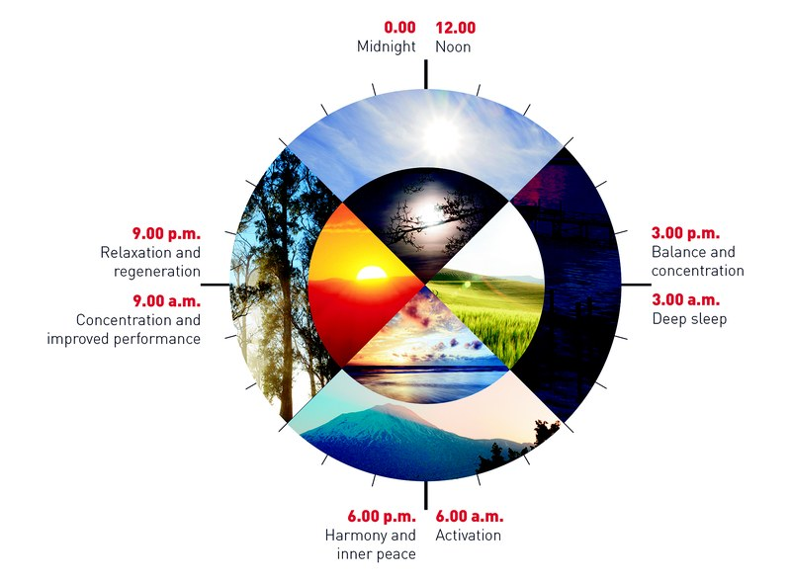
Human Centric Lighting
Human Centric Lighting (HCL) is becoming the next big step in lighting. Biologically effective lighting represents lighting systems that are appropriate to stimulate the biological organism, thus improving cognitive performance.
Emotionally effective lighting systems are designed to create emotionally stimulating environments and appealing atmospheres. Visual cues in design of a space aid us in our interactions with our surroundings. Using natural and electric lighting to illuminate objects in a space while minimizing negative effects such as glare and low contrast is the ultimate goal
HCL enhances Elder’s & disable’s life. Smart Lighting systems can provide the best lighting conditions to elder or/and visually impaired persons in order to facilitate the every-days actions and life offering them the feeling of larger autonomy and security.
Sun at zenith:
A lot of light
High colour temperature
Uniform light
Sunset:
Less light
Low colour temperature
Shadows
Light quantity and colour change during daytime

Slide 6
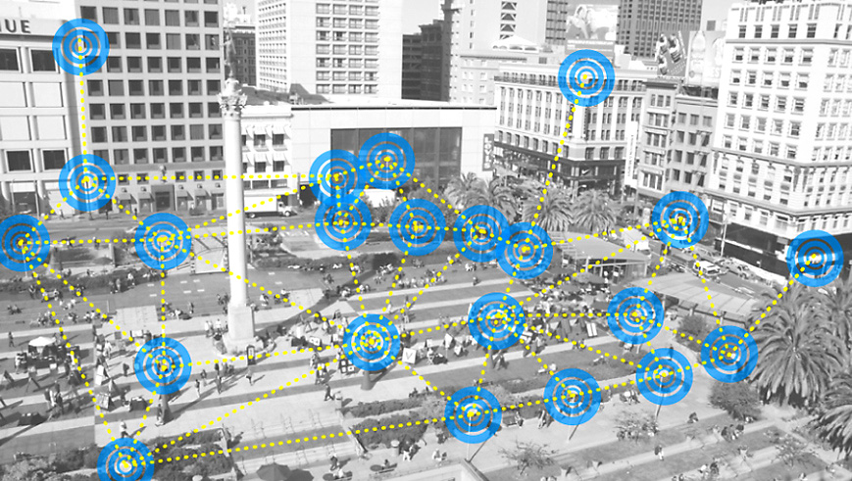
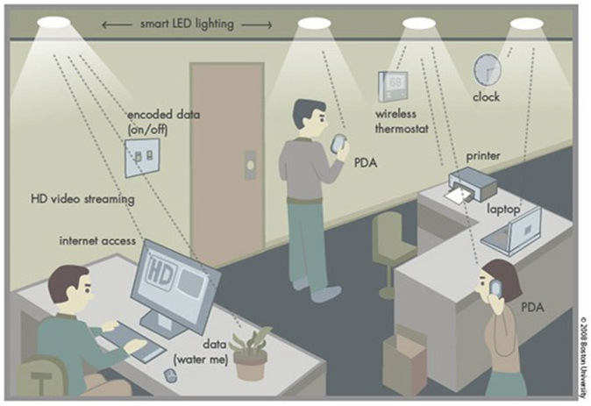
Lighting, an IoT system’s component…
A connected lighting system can be used as basis for connecting communicating objects thanks to visual light communication (VLC) and LiFi functionalities. Objects can communicate between them or/and a central system. VLC/LiFi offer a large band-pass to allow large data flows. A lighting network forms a dense mesh that can be used s for various applications & services
Illumination will become a sub-function of a more complex ICT (Information Communication Technology) system, which will be a sub-system in the Internet-of-Things (IoT) global system. Light will be the vector of new services and carrier of dataflows that will spawn additional products
According to market research, Li-Fi and in general VLC are expected to garner US$ 115 billion by 2022, registering a CAGR of 116,8% during the forecast period 2016 – 2022. US host important national lighting and ICT related industries that smart lighting technologies development will contribute in consolidating world leader position in that segments

Slide 7
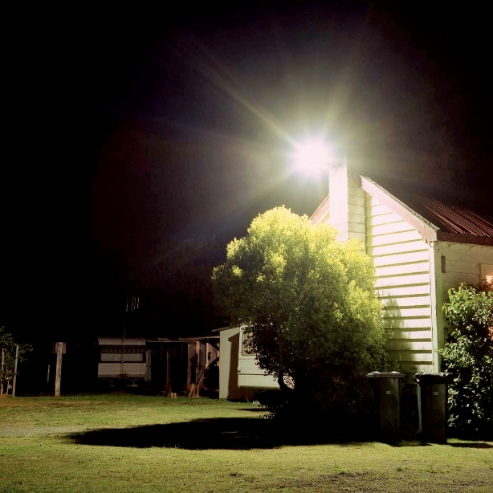
The ultimate solution: the “right human-centric smart lighting” concept
The solution:
Light-up smart, where it is needed, when it is necessary and as best as possible!
Illuminate doesn’t mean ”flood" objects, people or buildings with light!
Human & Social needs
Impacts
Technology
Smart Lighting development contributes to several world’s grand challenges
Contribute to Energy savings
Contribute to Healthy working environments and high task performance
Contribute to Silver Economy
Contribute to Lighting and IT industry rise

Slide 8
To achieve that objective cross-discipline efforts are required
New Standards
& Metrology
Inciting
Measures
Energy
Effective
Extra
Legislation
Market
knowledge
Environmental
Friendly
What is the
target ?
Innovative
Lighting
Systems
Technological
Development
Social
knowledge
User
Friendly
High Quality
Research
Training
High Performance
& Quality of life

Slide 9
Thank you!

