Slide 1
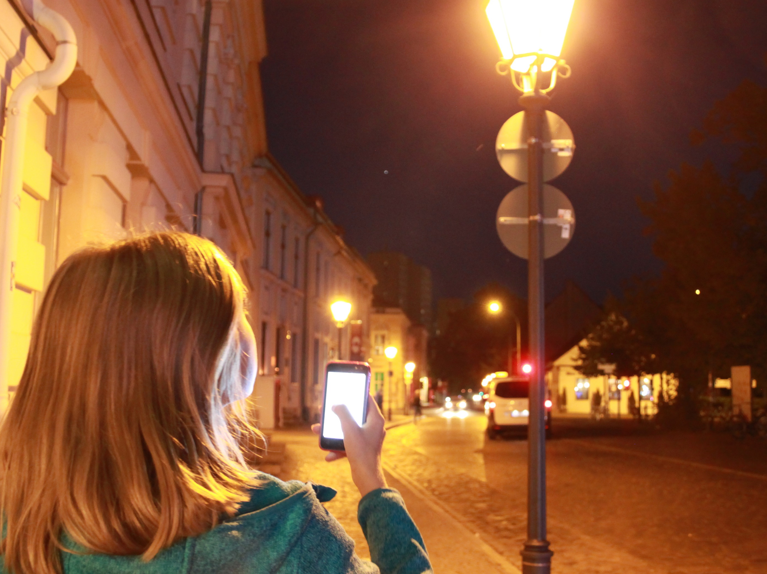



Which types of lighting are responsible for light emissions?
Christopher Kyba
August 6, 2021

Slide 2
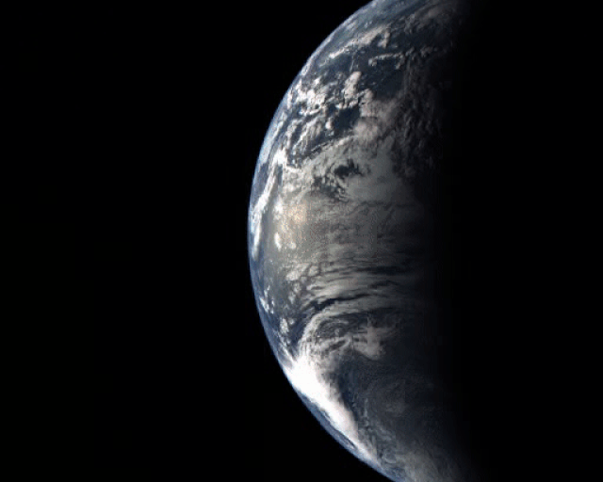
NASA MESSENGER, August 2, 2005

Slide 3
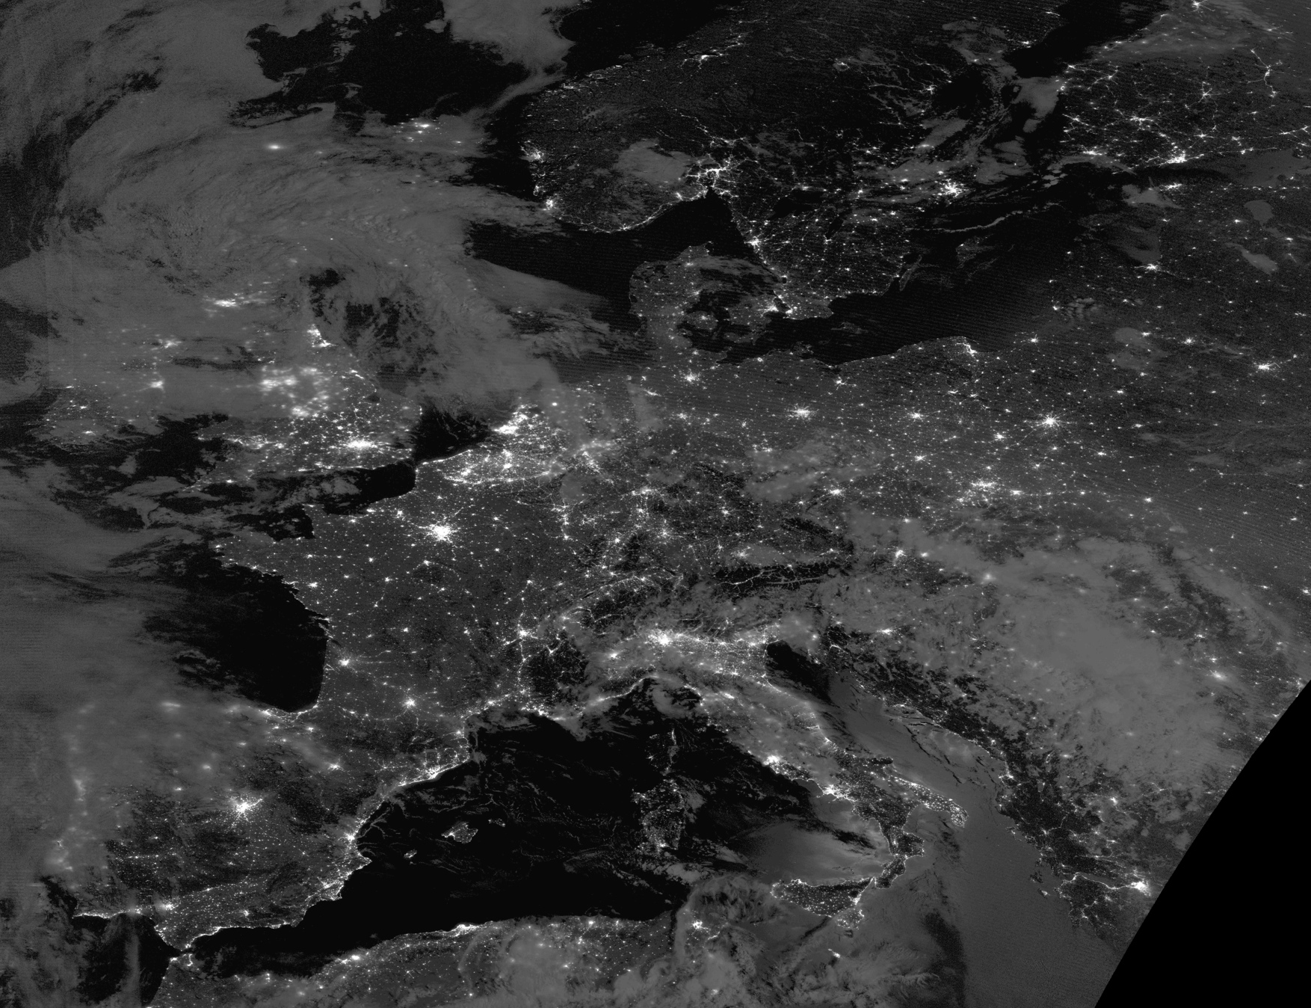
Notes:
September 16, 2014 MSG ~10 am (Meteosat second generation)
Next image, VIIRS DNB from the night before (~1:30 am)
We’ve changed the composition of the atmosphere and hydrosphere, we’ve introduced materials that aren’t biodegradable, and we cut down the primeval forest to allow space for agriculture.

Slide 4
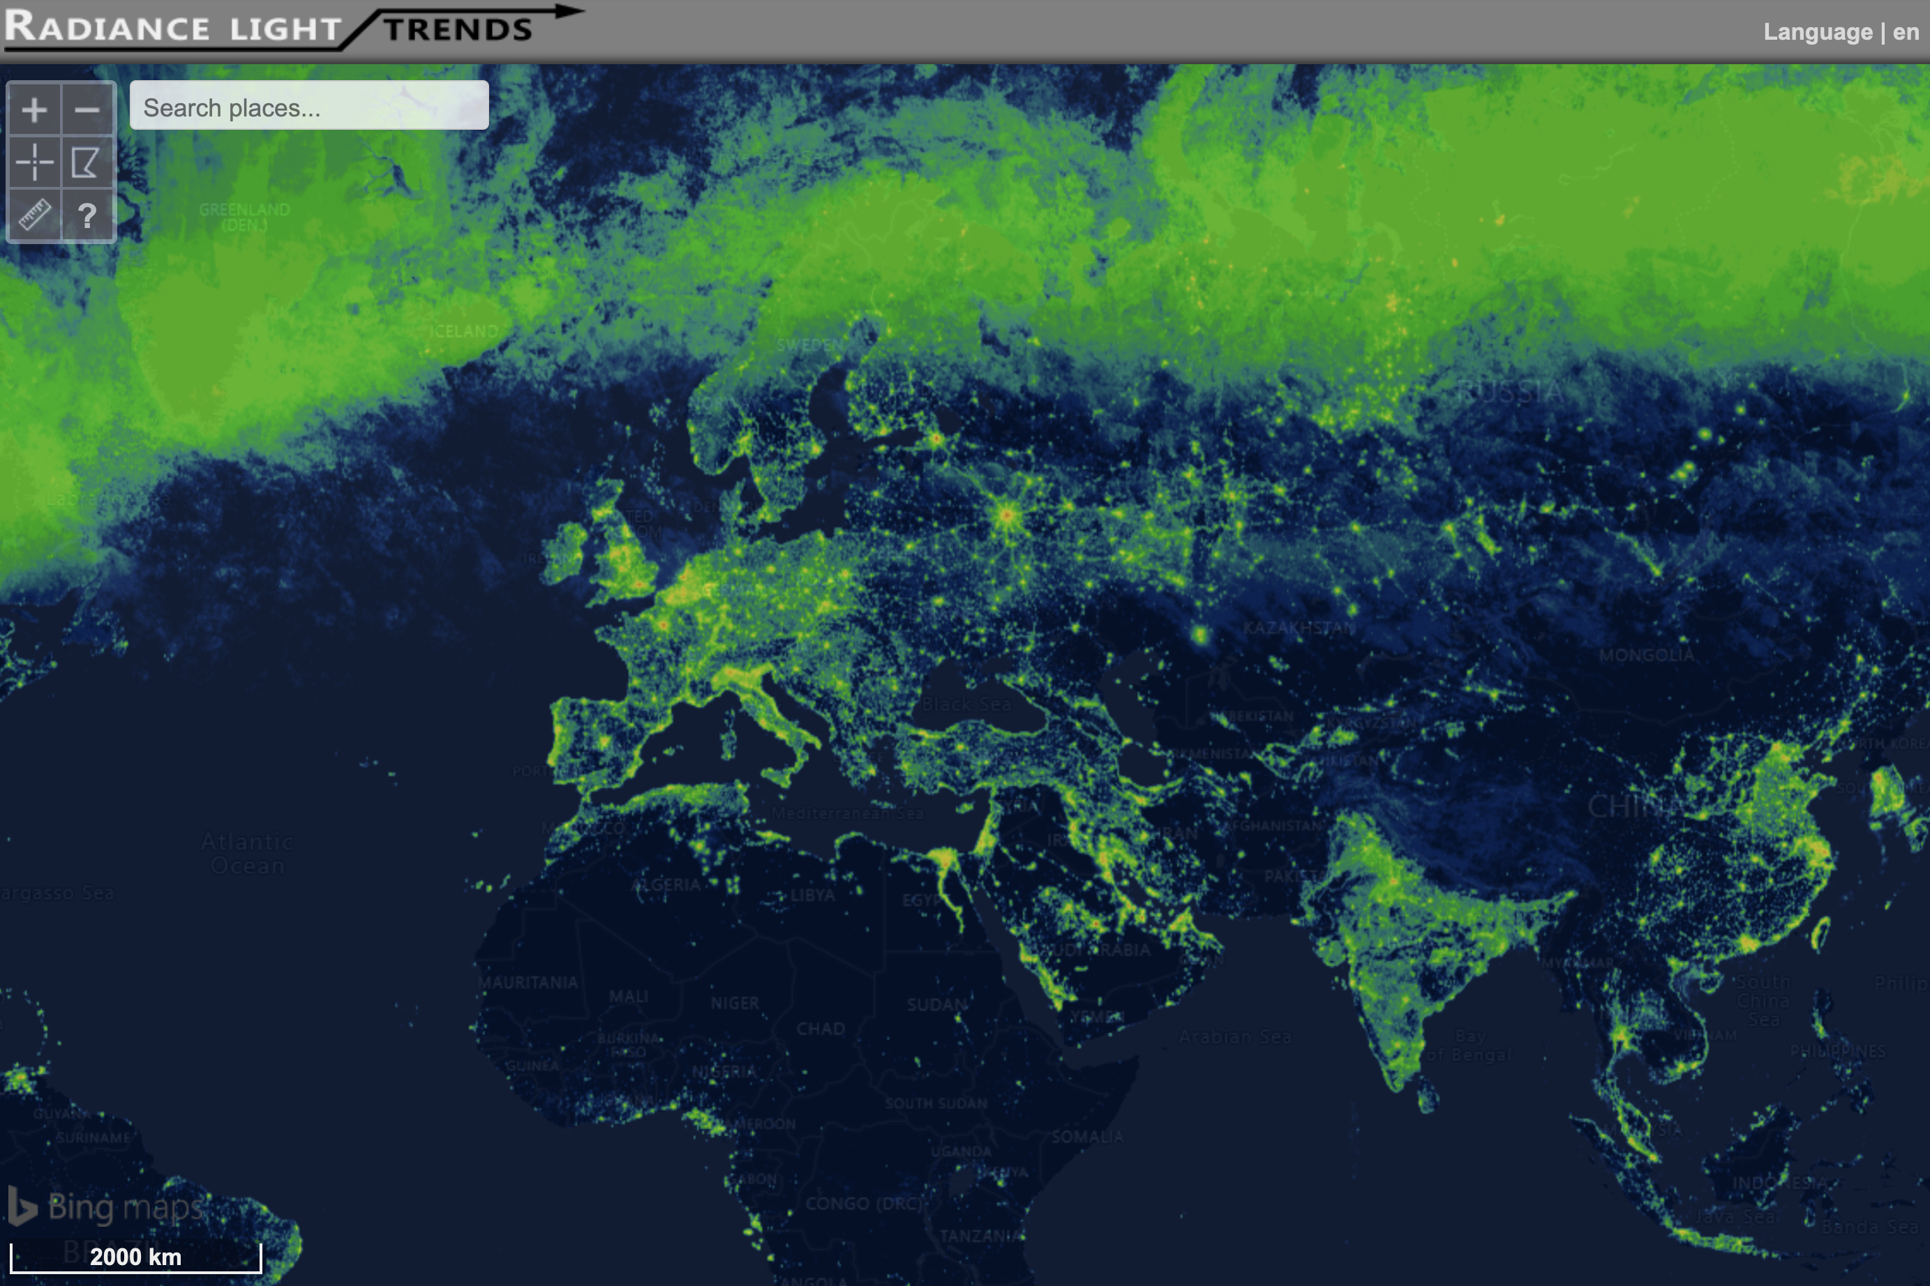
Radiance Light Trends
Notes:
September 16, 2014 MSG ~10 am (Meteosat second generation)
Next image, VIIRS DNB from the night before (~1:30 am)
We’ve changed the composition of the atmosphere and hydrosphere, we’ve introduced materials that aren’t biodegradable, and we cut down the primeval forest to allow space for agriculture.

Slide 5
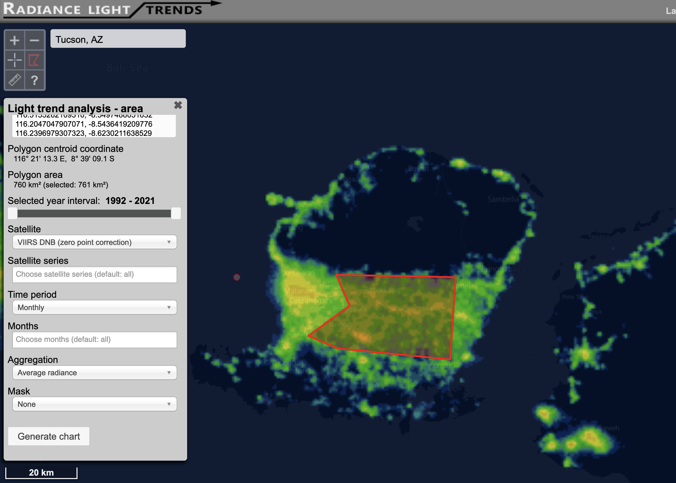
Rural areas of Lombok, Indonesia
Notes:
September 16, 2014 MSG ~10 am (Meteosat second generation)
Next image, VIIRS DNB from the night before (~1:30 am)
We’ve changed the composition of the atmosphere and hydrosphere, we’ve introduced materials that aren’t biodegradable, and we cut down the primeval forest to allow space for agriculture.

Slide 6
Rural areas of Lombok, Indonesia
11% annual increase in emissions
Notes:
September 16, 2014 MSG ~10 am (Meteosat second generation)
Next image, VIIRS DNB from the night before (~1:30 am)
We’ve changed the composition of the atmosphere and hydrosphere, we’ve introduced materials that aren’t biodegradable, and we cut down the primeval forest to allow space for agriculture.

Slide 7
Tucson, USA
15-20% decrease due to street lighting changes
Notes:
September 16, 2014 MSG ~10 am (Meteosat second generation)
Next image, VIIRS DNB from the night before (~1:30 am)
We’ve changed the composition of the atmosphere and hydrosphere, we’ve introduced materials that aren’t biodegradable, and we cut down the primeval forest to allow space for agriculture.

Slide 8
Annual change in radiance
2012-2016
Darker
Brighter
Kyba et al. (2017) Science Advances

Slide 9
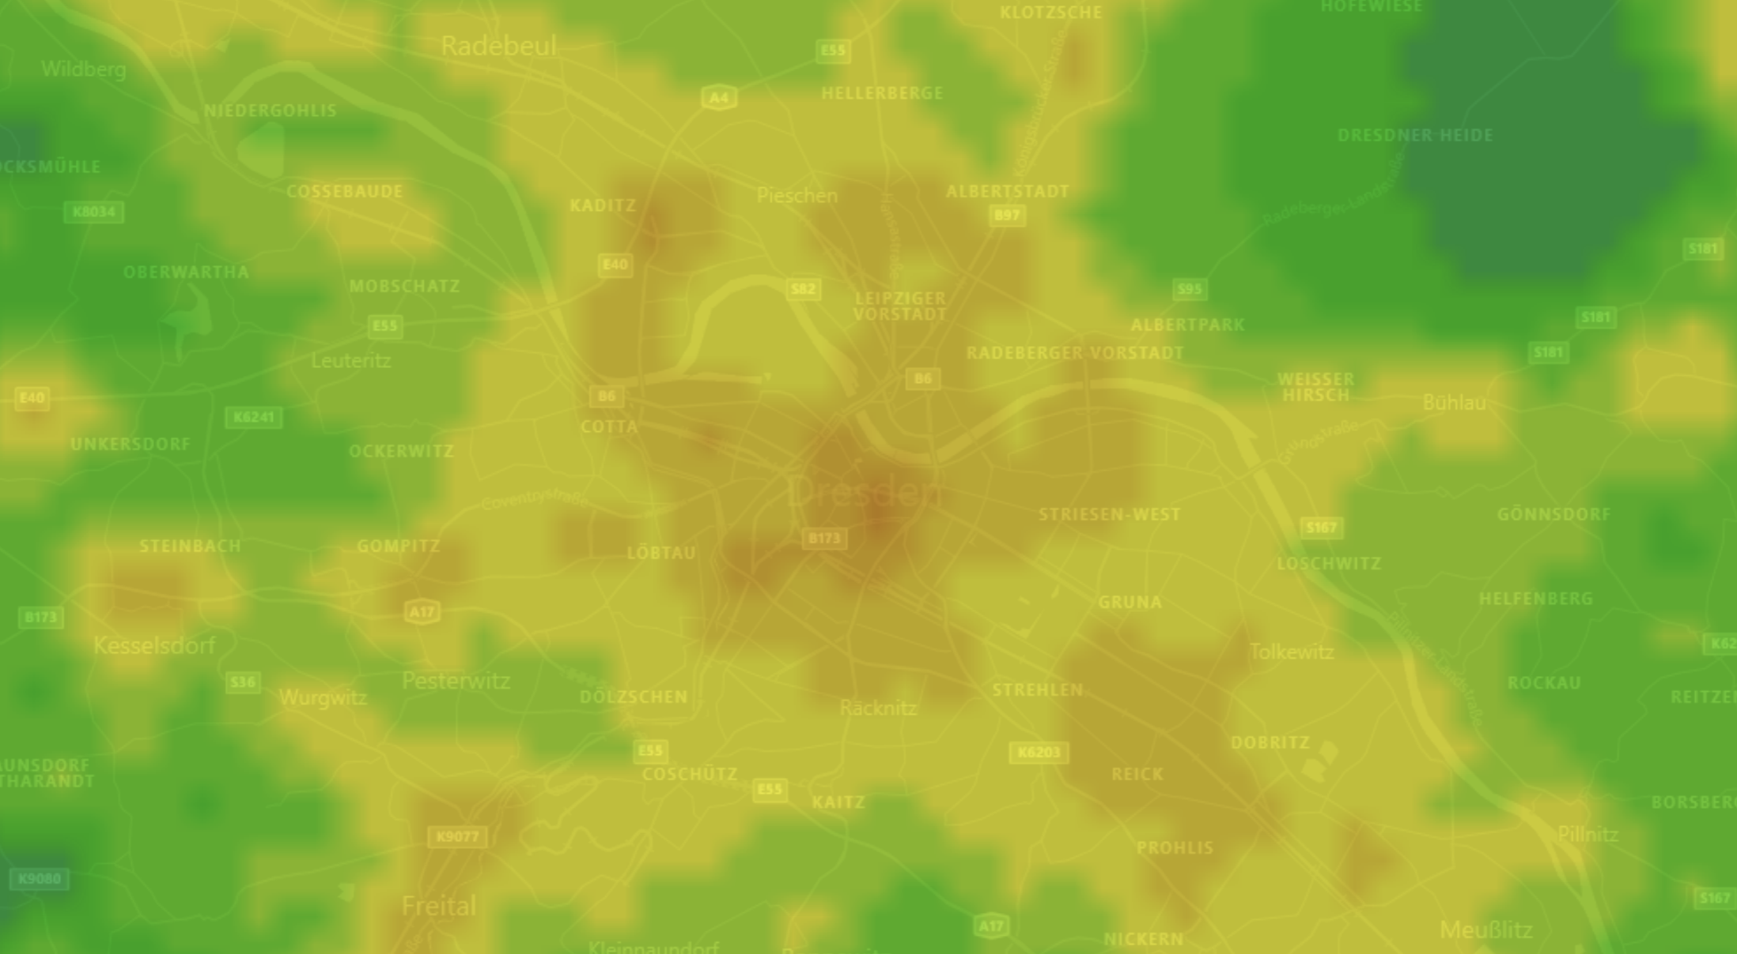
Dresden, Germany
Neustadt
21 nW/cm²sr
Altstadt
84 nW/cm²sr

Slide 10
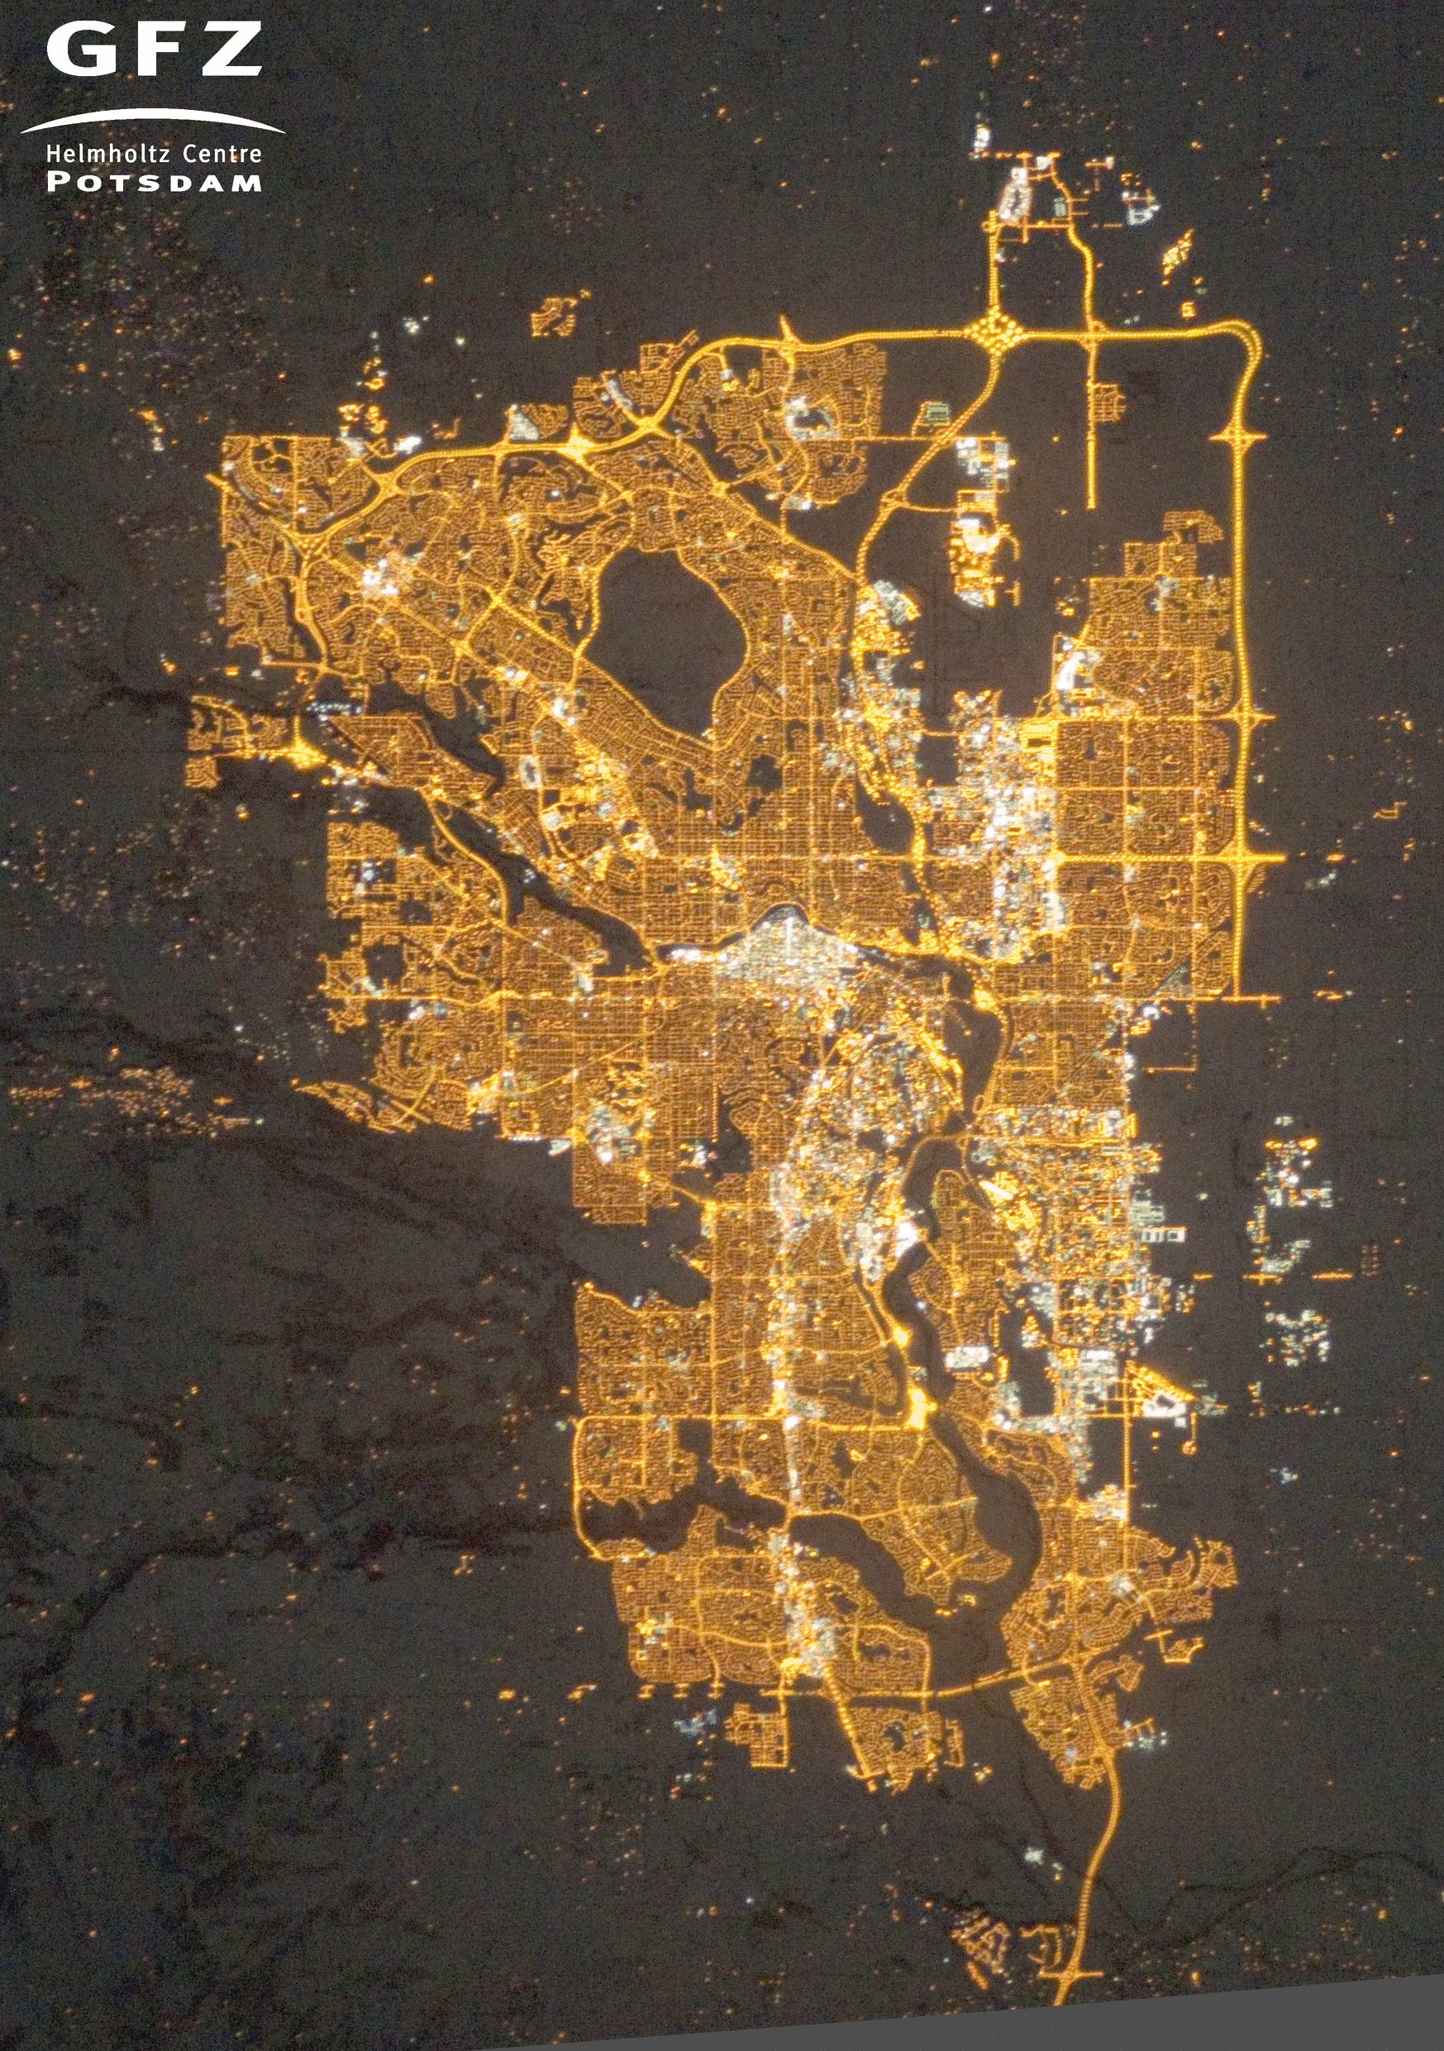

Slide 11
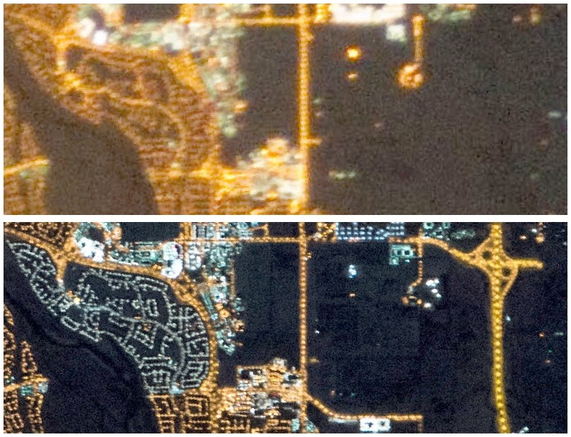

Slide 12
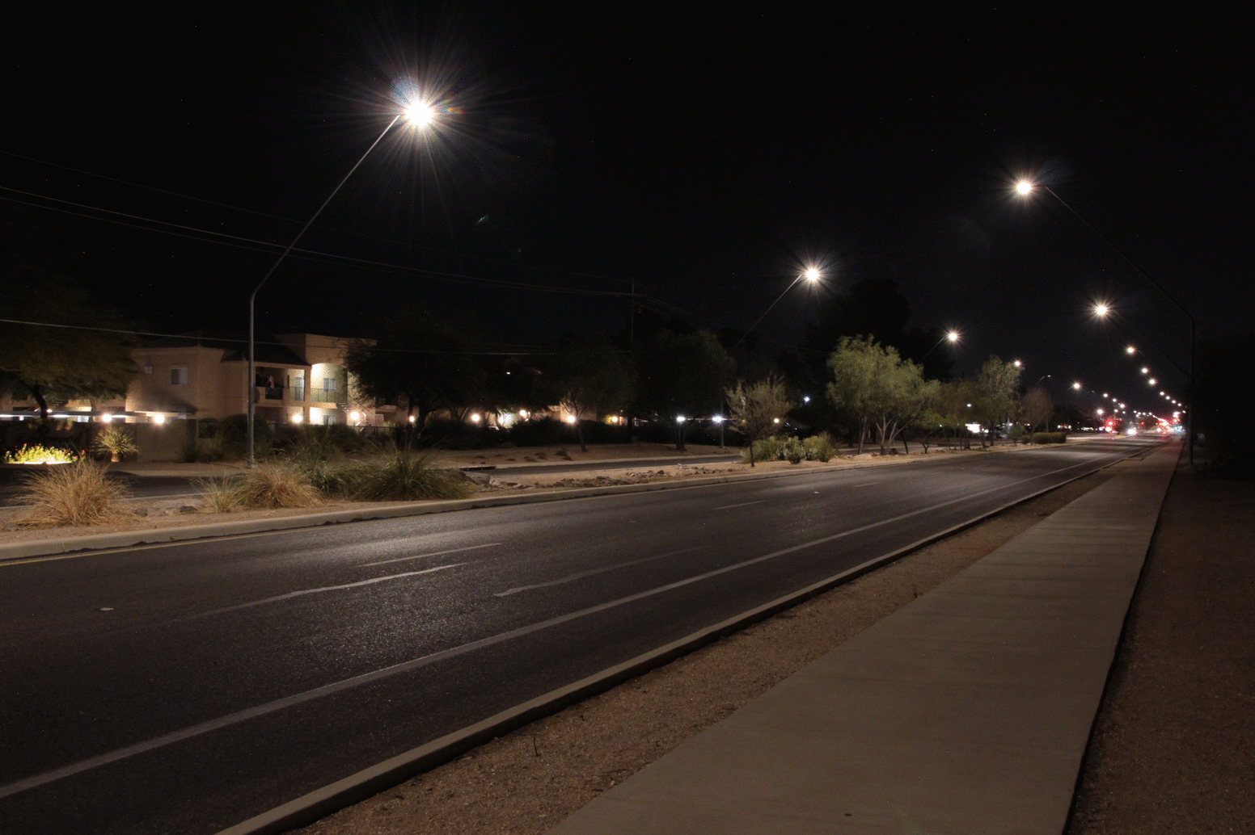
Tucson dimming experiment
Dimming set to 30%, 60% and 100% of maximum
14,000 of 19,500 City of Tucson streetlights involved in the test
Kyba et al. (2020)
Lighting Research & Technology

Slide 13
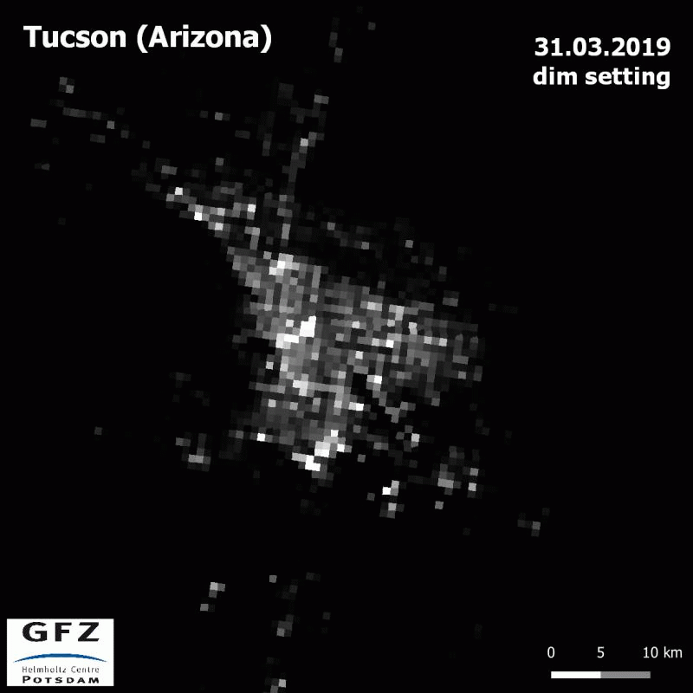
Tucson experiment
Change in city output was clearly visible in DNB images
Kyba et al. (2020)
Lighting. Res. Tech.

Slide 14
Results
City brightness
Streetlight power

Slide 15
Results
City brightness
Other lights
Streetlight power

Slide 16
Results
City brightness (%)
Only 13% of the light emissions from Tucson after midnight are due to streetlights!
Streetlight power (MW)

Slide 17
German villages
City brightness (rel.)
Streetlight luminance (rel.)

Slide 18
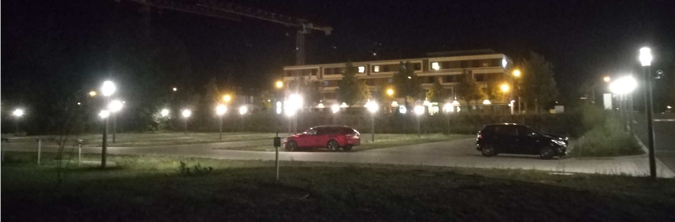

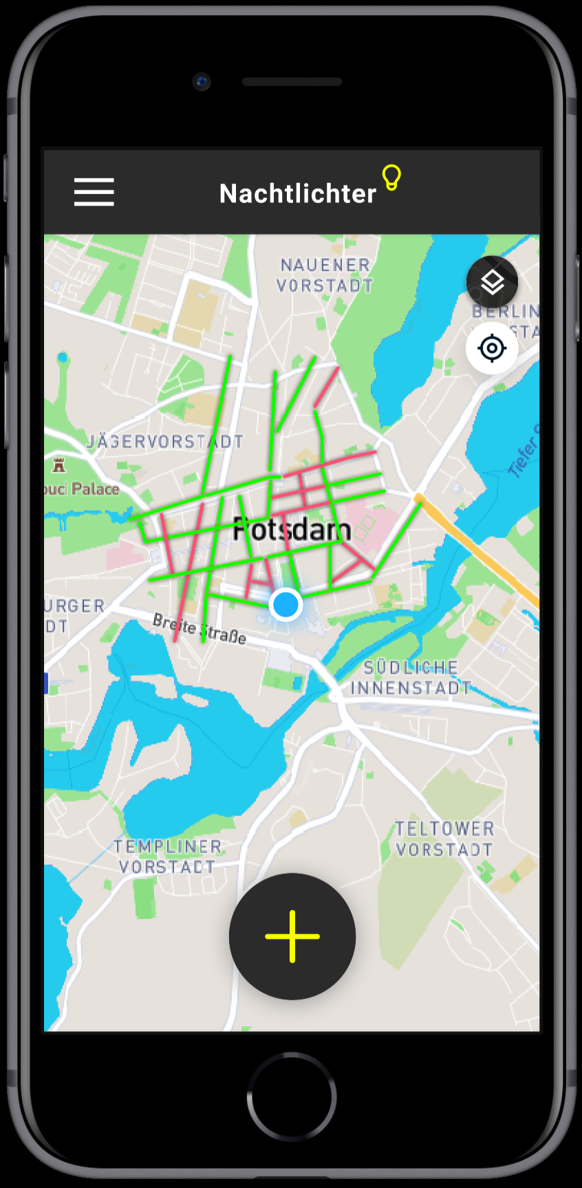
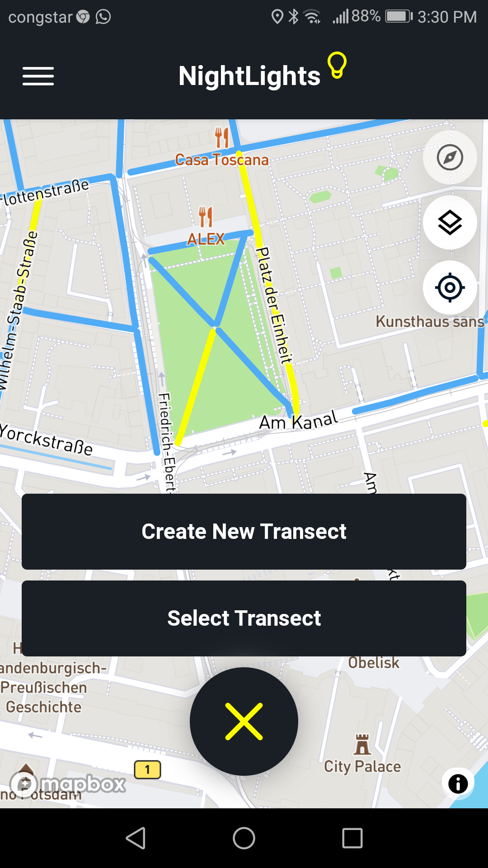
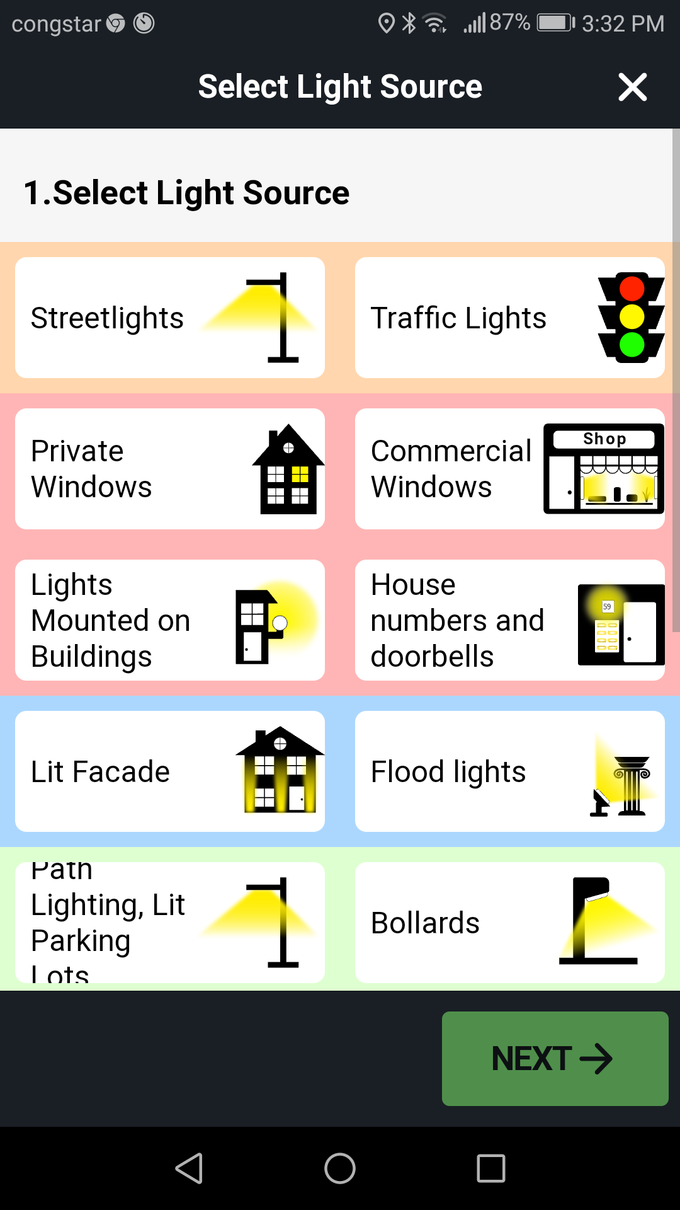
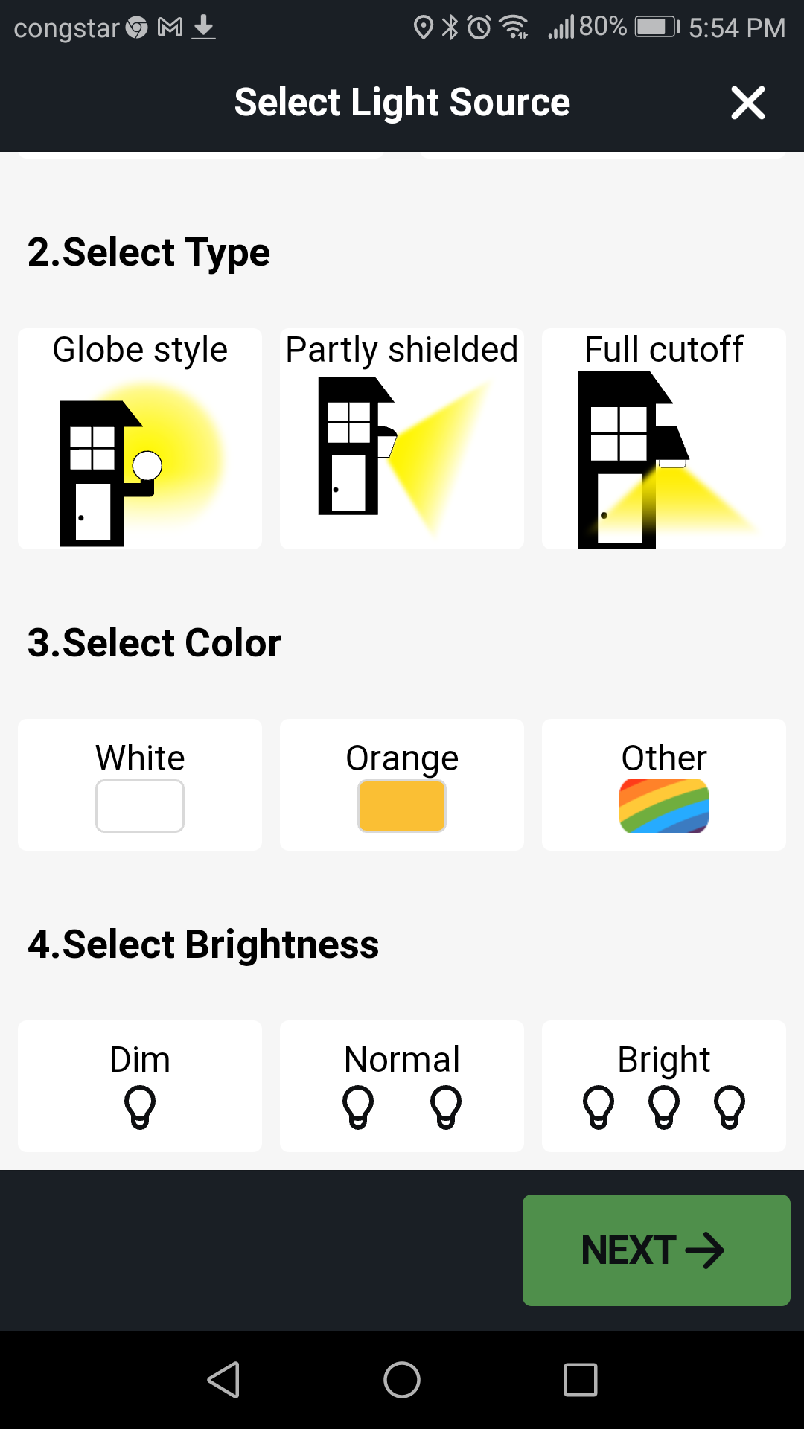
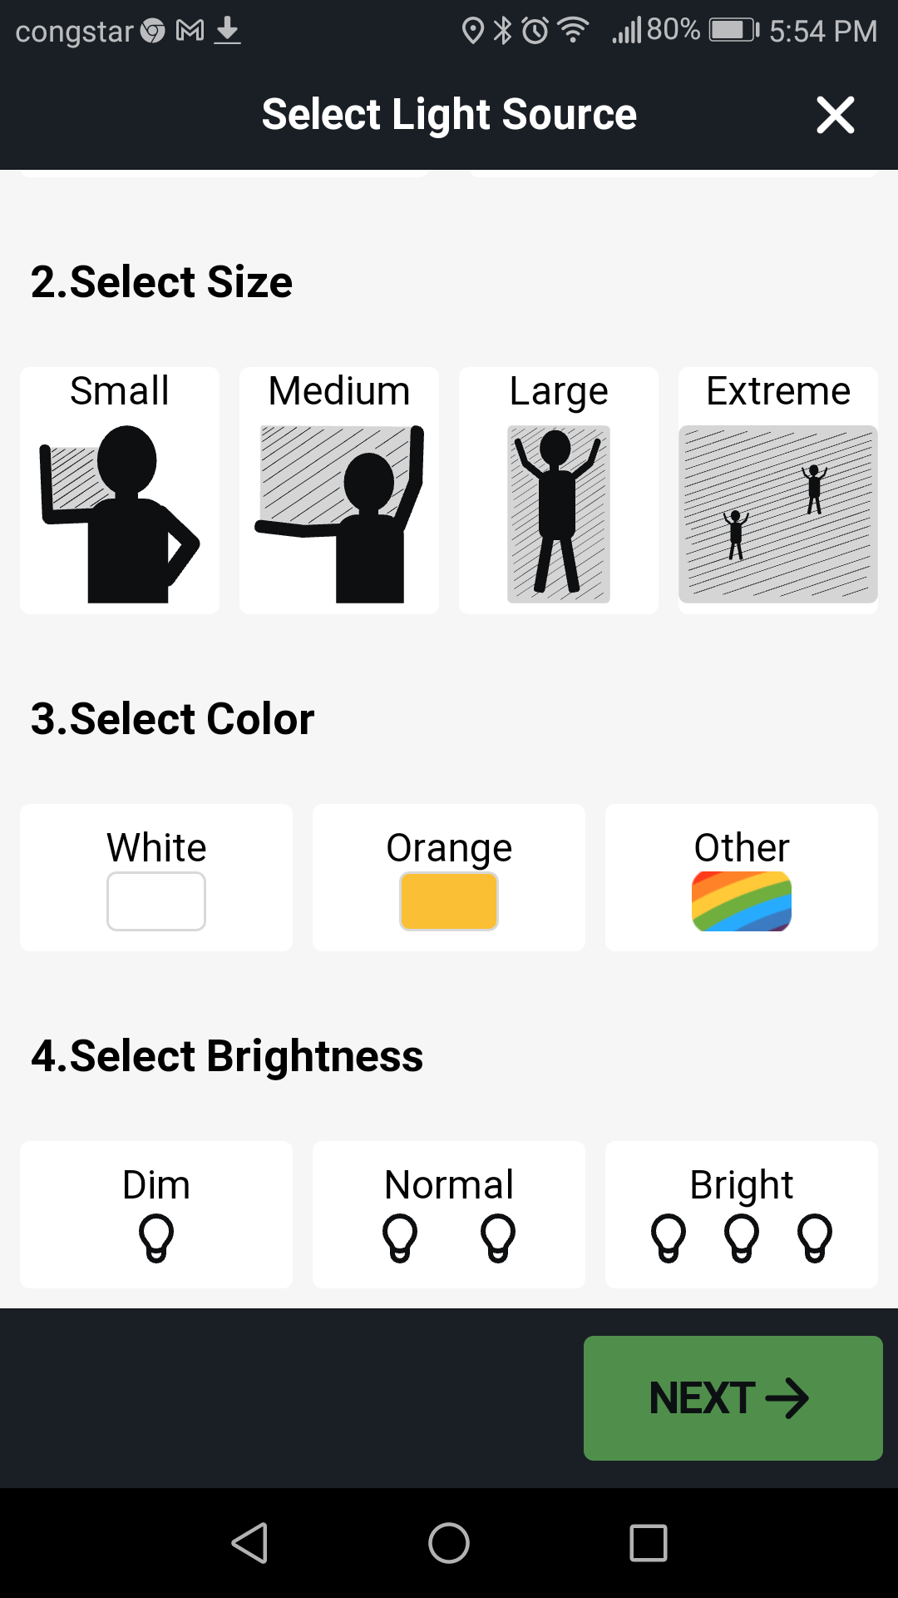
Nachtlichter App

Slide 19
Nachtlichter research questions
What is the relationship between satellite radiance and number and type of lights on the ground?
How does the nature of lighting change on an urban to rural gradient?
Neustadt
21 nW/cm²sr
Altstadt
84 nW/cm²sr

Slide 20
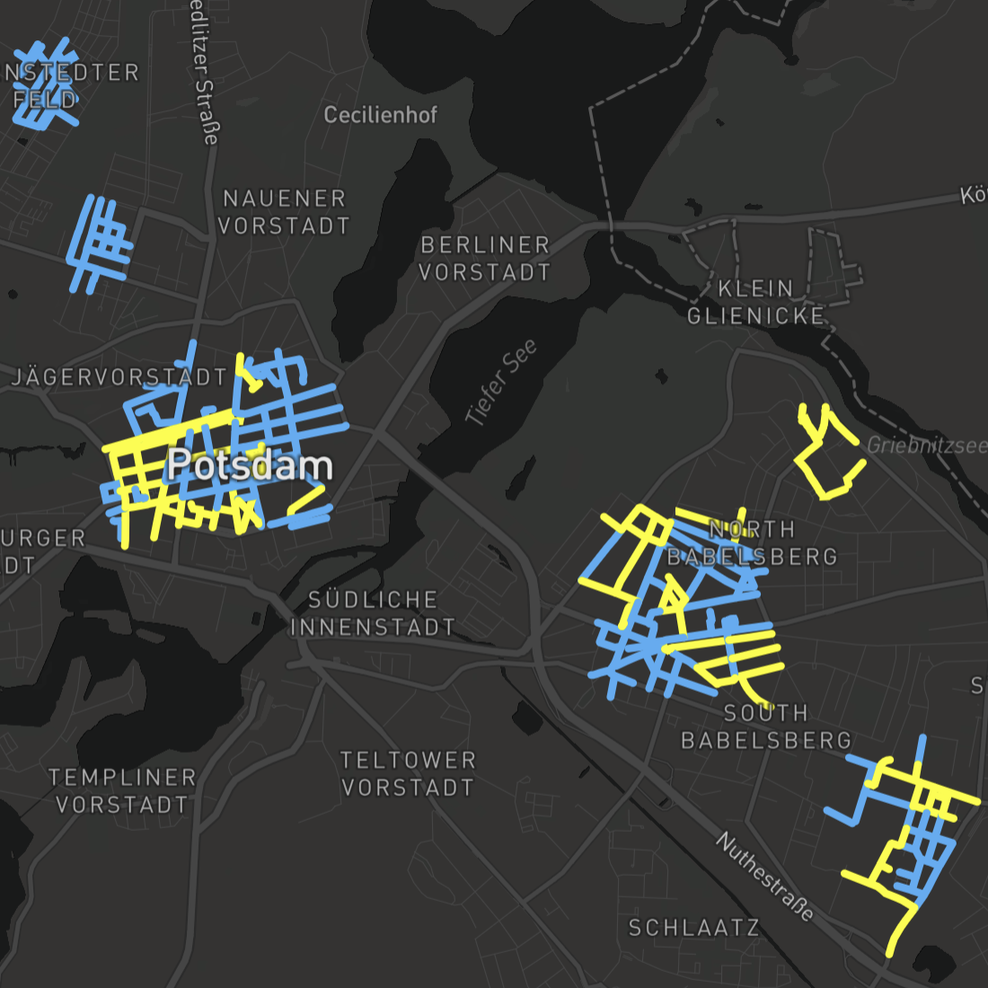
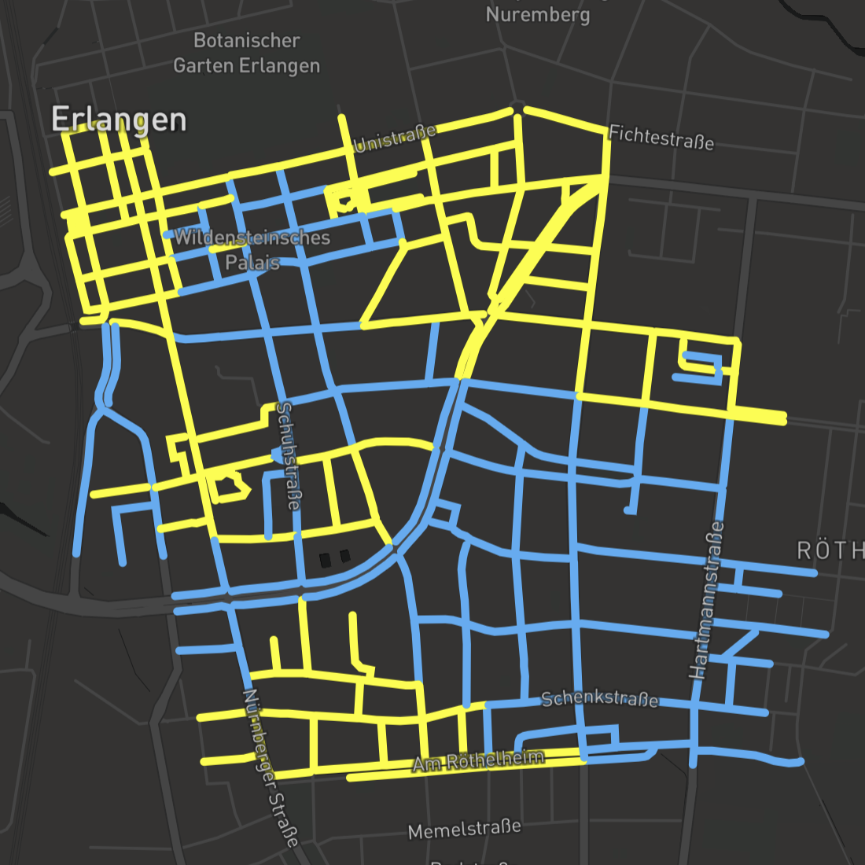
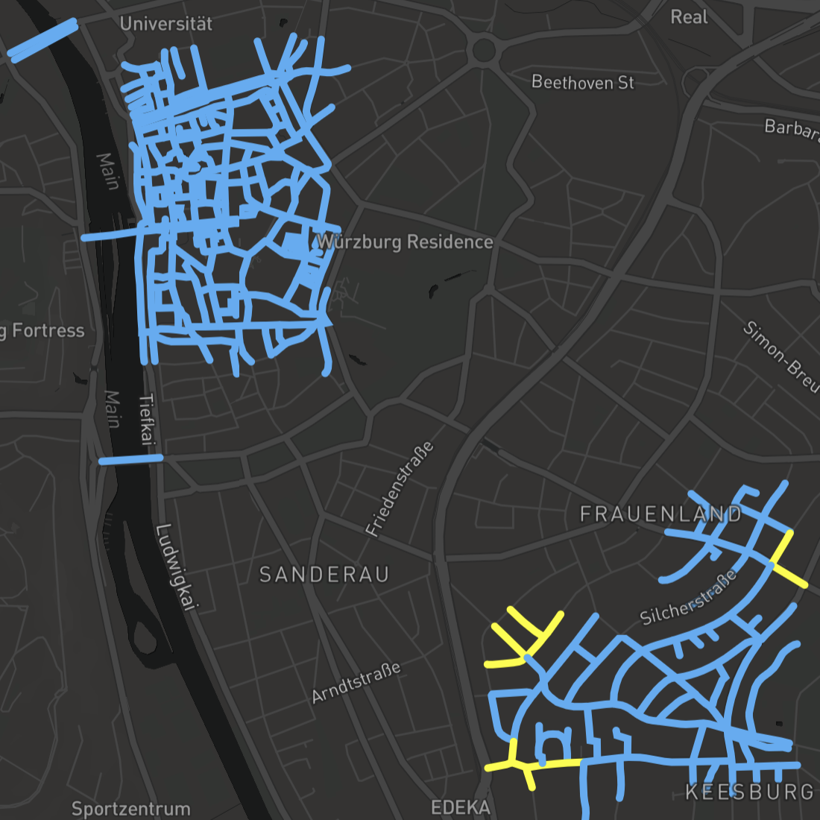
24 campaign locations
>250 km of roadway hundreds of thousands of lights
Potsdam
Erlangen
Würzburg

Slide 21
Friedrich-Ebert-Straße, Potsdam
Lights along a 130 meter transect:
  10 streetlights
  51 illuminated signs
  32 canopy lights
  14 private windows
  13 commercial windows
  3 floodlights
  3 “other” lights
  2 lights on buildings
1 light/meter
12 other light sources for each streetlight

Slide 22
To successfully limit light emissions we ought to know what the sources are and how they are changing
Notes:
September 16, 2014 MSG ~10 am (Meteosat second generation)
Next image, VIIRS DNB from the night before (~1:30 am)
We’ve changed the composition of the atmosphere and hydrosphere, we’ve introduced materials that aren’t biodegradable, and we cut down the primeval forest to allow space for agriculture.

